Slide 1

PRESENTATION ON VARIOUS PYTHON LIBRARIES
SUBMITTED BY -

Slide 2
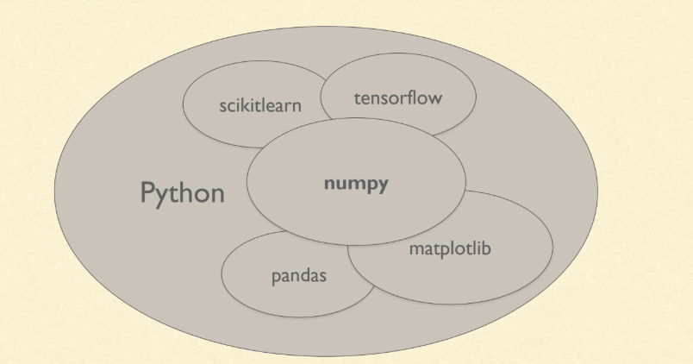
The complete Machine Learning eco-system.

Slide 3
NumPy

Slide 4
NumPy
Numpy Stands for "Numeric Python" or "Numerical Python".
Features of NumPy
Array-oriented computing
Efficiently implemented multi-dimensional arrays
Designed for scientific computation
Library of high-level mathematical functions
NumPy’s main object is the homogeneous multidimensional array .

Slide 5
BENEFITS OF NUMPY ARRAYS OVER LISTS
NumPy's arrays are more compact than Python lists which in Python, would take at least 20 MB or so, while a NumPy 3D array with single-precision floats in the cells would fit in 4 MB.
Access in reading and writing items is also faster with NumPy.
NumPy is not only more efficient , it is also more convenient.
A lot of vector and matrix operations in NumPy arrays allows one to avoid unnecessary work. And they are also efficiently implemented.

Slide 6
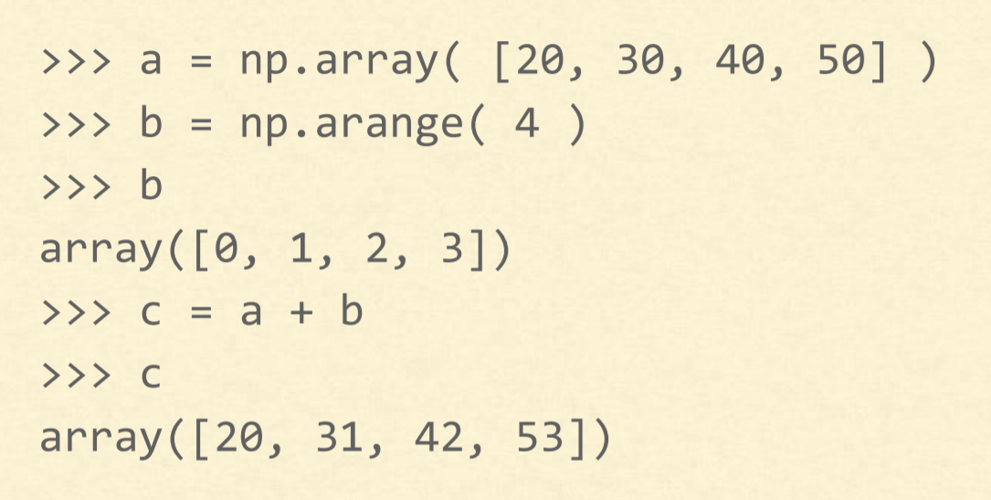
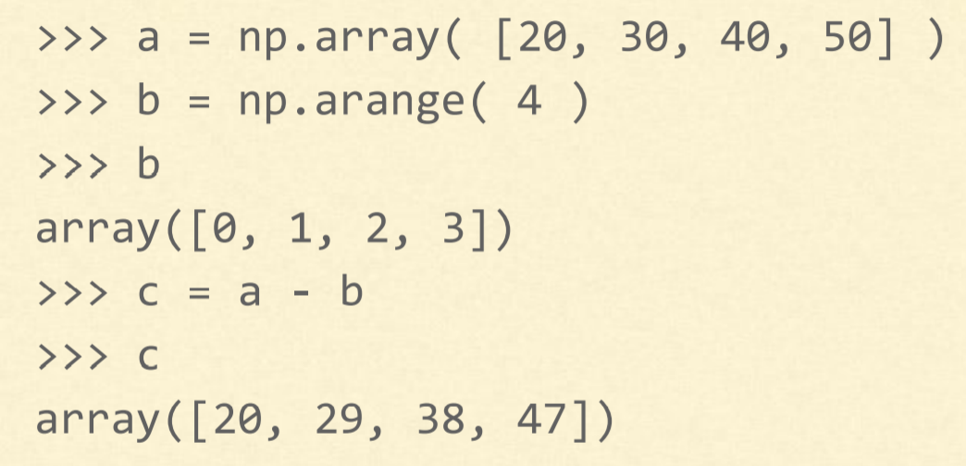
Basic Operations which can be performed on NumPy arrays
Addition in NumPy arrays
Subtraction in NumPy arrays

Slide 7
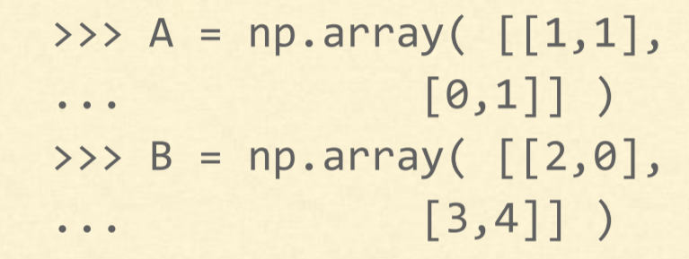
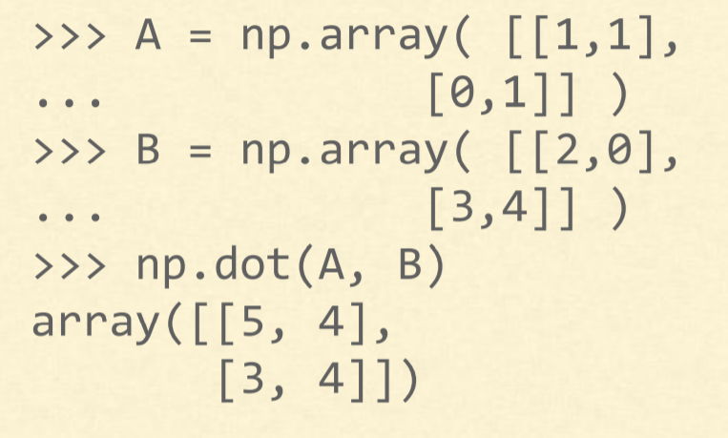
Element wise product in NumPy arrays
Matrix Product in NumPy arrays

Slide 8
Some More Operations on NumPy Arrays
Division in NumPy arrays
Modulus in NumPy arrays
Exponents in NumPy arrays
Conditional Operators on NumPy arrays

Slide 9
PANDAS

Slide 10
What is Pandas?
One of the most widely used Python libraries in Data Science after NumPy and Matplotlib
The Pandas library Provides
High-performance
Easy-to-use data structures and
Data analysis tools
Many features available in Excel are available programmatically like Creating pivot tables , Computing columns based on other columns , Plotting graphs
When working with tabular data, such as data stored in spreadsheets or databases, Pandas is the right tool to make use. Pandas will help to explore, clean and process data. In Pandas, a data table is called a Dataframe

Slide 11
PANDAS SERIES
Pandas Series is a one-dimensional labeled array capable of holding data of any type
The axis labels are collectively called index. Pandas Series is nothing but a column in an excel sheet
Labels need not be unique but must be a hashable type. The object supports both integer and label-based indexing and provides a host of methods for performing operations involving the index.

Slide 12
DataFrames - Overview
Pandas DataFrame is two-dimensional size-mutable, potentially heterogeneous tabular data structure with labeled axes (rows and columns).
A Data frame is a two-dimensional data structure, i.e., data is aligned in a tabular fashion in rows and columns. Pandas DataFrame consists of three principal components, the data, rows, and columns.
When dealing with large DataFrames, it is useful to get a quick overview of its content

Slide 13
USE OF PANDAS IN DATA SCIENCE
Pandas is generally used for data science because pandas is used in conjunction with other libraries that are used for data science. It is built on the top of the NumPy library which means that a lot of structures of NumPy are used or replicated in Pandas.
The data produced by Pandas is often used as input for plotting functions of Matplotlib, statistical analysis in SciPy, machine learning algorithm in Scikit-learn.
Pandas program can be run from any text editor but it is recommended to use Jupyter Notebook for this as Jupyter given the ability to execute code in a particular cell rather than executing the entire file. Jupyter also provides an easy way to visualize pandas dataframe and plots.

Slide 14
MATPLOTLIB

Slide 15
WHAT IS MATPLOTLIB
Matplotlib is a Python 2D plotting library
Produces publication quality figures in a variety of Hardcopy formats and Interactive environments
Matplotlib can be used in ○ Python scripts ○ Python and IPython shell ○ Jupyter notebook ○ Web application servers ○ GUI toolkits
One of the greatest benefits of visualization is that it allows us visual access to huge amounts of data in easily digestible visuals. Matplotlib consists of several plots like line, bar, scatter, histogram etc.

Slide 16
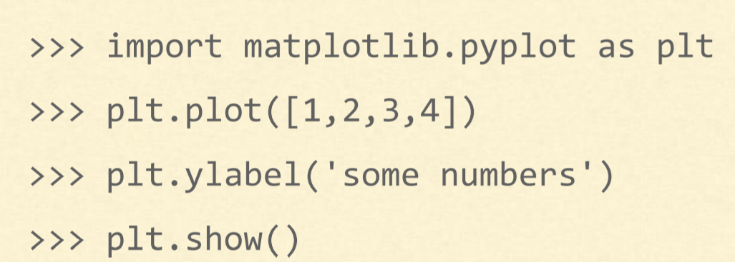
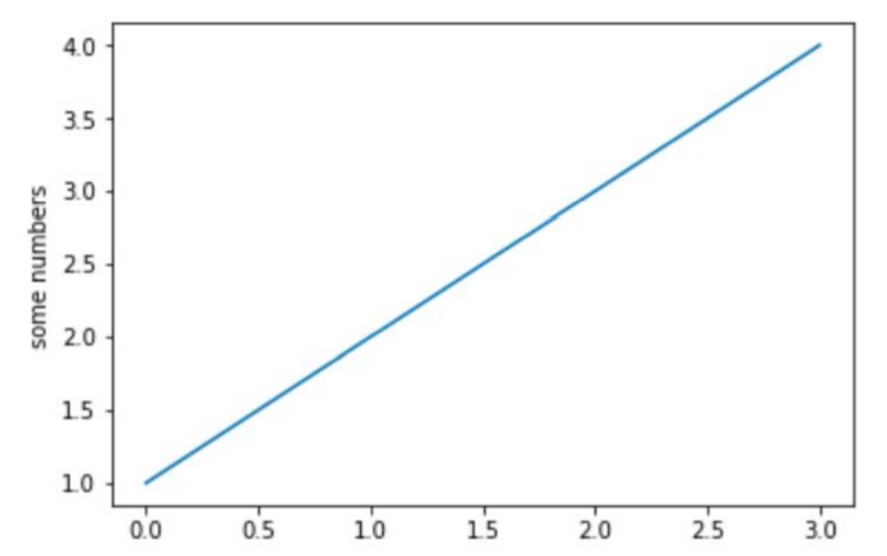
Matplotlib-pyplot module
It is a Collection of functions that make matplotlib work like MATLAB
Majority of plotting commands in pyplot have MATLAB analogs with similar arguments

Slide 17
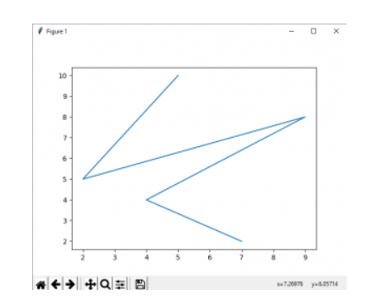
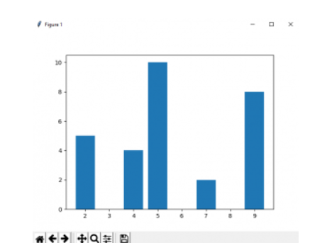
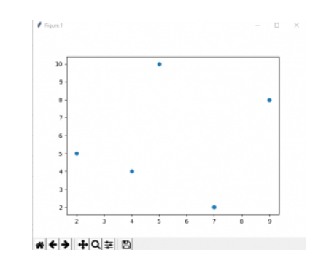
SOME BASIC PLOTS IN MATPLOTLIB
Line plot Bar plot Scatter Plot

Slide 18
SEABORN

Slide 19
An introduction to seaborn
Seaborn is a library for making statistical graphics in Python. It is built on top of matplotlib and closely integrated with pandas data structures.
Here is some of the functionality that seaborn offers:
A dataset-oriented API for examining relationships between multiple variables
Specialized support for using categorical variables to show observations or aggregate statistics
Options for visualizing univariate or bivariate distributions and for comparing them between subsets of data
Automatic estimation and plotting of linear regression models for different kinds dependent variables

Slide 20
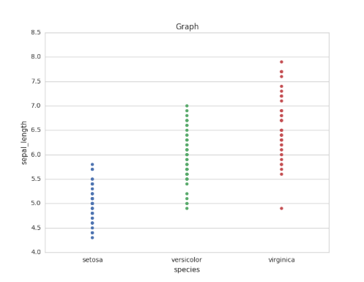
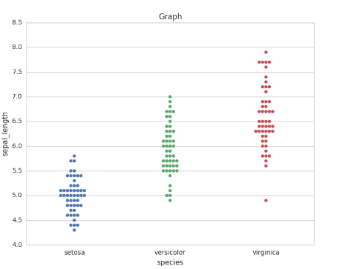
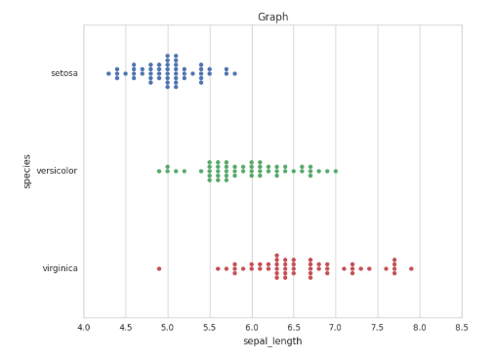
Plotting scatter plots with Seaborn
STRIPPLOT SWARMPLOTS

Slide 21
COMPARISION BETWEEN MATPLOTLIB AND SEABORN LIBRARIES
MATPLOTLIB
SEABORN
Matplotlib is mainly deployed for basic plotting. Visualization using Matplotlib generally consists of bars, pies, lines, scatter plots and so on.
Matplotlib works with data frames and arrays.
Seaborn , provides a variety of visualization patterns. It uses fewer syntax and has easily interesting default themes. It specializes in statistics visualization and is used if one has to summarize data in visualizations and also show the distribution in the data.
Seaborn works with the dataset as a whole and is much more intuitive than Matplotlib.

